Slide 1
PALLIATIVE CARE
An overview

Slide 2
You matter because you are you. You matter to the last moment of your life, and we will do all we can not only to help you die peacefully, but also to live until you die.
-Cicely Saunders-

Slide 3

Patient’s Journey Through any sickness when medical treatment fails
Impact on family
DEATH
Treatment options
Diagnostic
process
GAP
Bereavement
Hospital
Symptom control

Slide 4
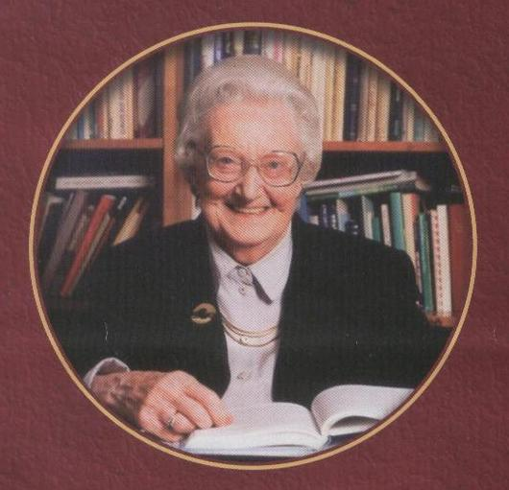
PALLIATIVE CARE
Its origin is in the Latin word pallium, meaning a cloak. It means to mitigate the sufferings of the patient, not to necessarily effect cure.
HOSPICE
What is it?

Slide 5
Palliative Care
Palliative Care is an approach that improves the Quality of Life of Patients and their Families facing the problems associated with life-threatening illness, through the Prevention and Relief of Suffering by means of early identification and impeccable Assessment and Treatment of Pain and other problems, Physical, Psychosocial and Spiritual.
Revised 2002. Sepulveda et al.
JPSM 2002; 24: 91-96

Slide 6
DEFINING PALLIATIVE CARE
World Health Organisation
“Palliative care is an approach to care that improves the quality of life of patients and their families facing problems associated with life threatening illness, through the prevention and relief of suffering by means of early identification and impeccable assessment and treatment of pain and other problems, physical, psychological and spiritual”.

Slide 7
DEFINING PALLIATIVE CARE
Palliative care is:
….the active holistic care of patients with advanced, progressive illness. Management of pain and other symptoms and provision of psychological, social and spiritual support is paramount. The goal of palliative care is achievement of the best quality of life for patients and their families. Many aspects of palliative care are also applicable earlier in the course of the illness in conjunction with other treatments..(From NICE 2004 Improving Supportive and Palliative Care for Adults with cancer)

Slide 8

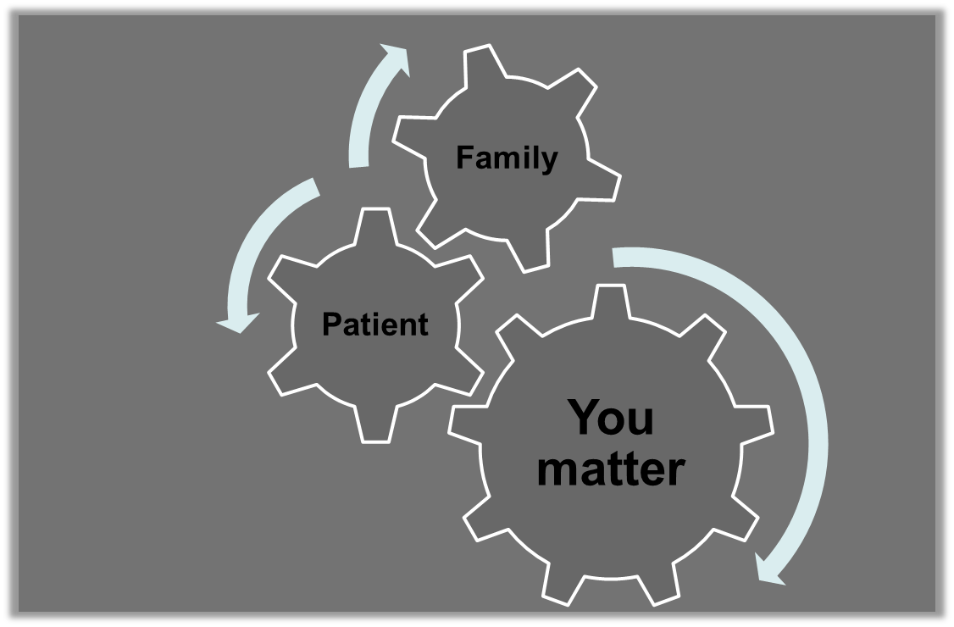
First of all

Slide 9
Main aims
Improve the Quality of Life
Avoid the avoidable suffering
Wellbeing
Building Capacity : empowerment to adjust, relief and support the unavoidable suffering
Promote comfort
Comprehensive Care
OMS 2002

Slide 10
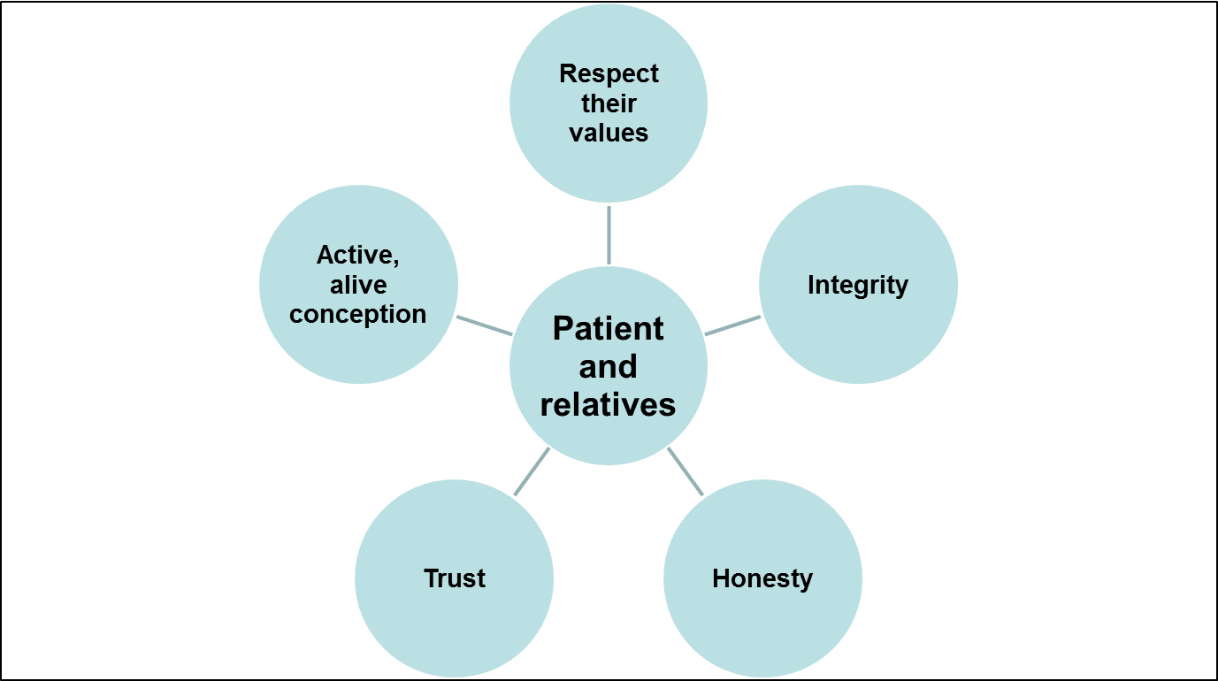
Values

Slide 11
10 instruments for palliative care
Needs assessment.
Systematic therapeutic Plan.
Symptom control.
Emotional support.
Information and communication.
Clinical ethics as the method for decisions
Change in the micro organization: the team work
Change in the organization of resources.
Evaluation and monitoring results quality and results.
Education, training, and research
And….. Advance Care Planning and Case management
and continuity of care

Slide 12
PRINCIPLES
Focus on quality rather than quantity of life
Life affirming but death accepting
Effective communication at all levels
Respect for autonomy and choice
Effective symptom management
Holistic, multi-professional approach
Caring about the person and those who matter to that person

Slide 13
KEY ISSUES
Information needs
Being treated as a human being
Empowerment
Physical needs
Continuity of care
Psychological needs
Social needs
Spiritual needs

Slide 14
ILLNESS MANAGEMENT
2. PHYSICAL
3. PSYCHOLOGICAL
8. LOSS, BEREAVEMENT
4. SOCIAL
PATIENT & FAMILY
7. CARE
AT THE END OF LIFE /
DEATH MANEGEMENT
6. PRACTICAL
5.SPIRITUAL

Slide 15
1. ILLNESS MANAGEMENT
Primary diagnosis, prognosis, tests
Secondary diagnosis (for example, dementia, psychiatric diagnosis, use of drugs, trauma)
Co-morbid (delirium, attacks, organs failure)
Adverse episodes (collateral effects, toxicity)
2. PHYSICAL
Pain & other symptoms
Conscience level, cognition
Function, safety, materials:
Motor (mobility, shallowness, excretion)
Senses (hearing, sight, smell, taste, touch)
Physiologic (breathing, circulation)
Sexual
Fluids, nutrition, wounds
Habits (alcohol, smoking)
3. PSYCHOLOGICAL
Personality, strengths, behavior, motivation
Depression, anxiety
Emotions (anger, distress, hope, loneliness)
Fears (abandonment, burdens, death)
Control, dignity, independence
Conflict, guilt, stress, assuming answers
Self-image, self-esteem
8. LOSS, BEREAVEMENT
Loss
Pain (for example, chronic acute, anticipatory)
Bereavement planning
Mourning
4. SOCIAL
Values, cultural, beliefs, practices
Relations, roles with the family, friends, community
Isolation, abandonment, reconciliation
Safe, comforting environment
Privacy, intimacy
Routines, rituals, leisure, vocations
Financial resources, expenses
Legal (powers of attorney for businesses, health attention, advanced directives, last desire/testament beneficiaries)
PATIENT & FAMILY
Characteristics
Demographic (age, sex, race, contact information)
Culture (ethnic, language, nurture)
Personal values, beliefs, practices, strengths
Development status, education, alphabetization
Disabilities
7. CARE AT THE END OF LIFE/DEATH MANAGEMENT
End of life (businesses ending, relationships closing, to say goodbye)
Delivery of gifts (objects, money, organs, thoughts)
Creation of legacy
Preparation for the awaited death
Anticipation changes in agony
Rituals
Certification
Care of agony
Funerals
6. PRACTICAL
Everyday activities (personal care, home work)
Dependents, pets
Access to telephone, transport
Care
5.SPIRITUAL
Significance, value
Existential, transcendental
Values, beliefs, practices, affinities
Spiritual advisors, rituals
Symbols, icons

Slide 16
Patient / Family
Characteristics
Demographic (age, sex, race, contact information)
Culture (ethnic, language, nurture)
Personal values, beliefs, practices, strengths
Development status, education, alphabetization
Disabilities

Slide 17
1. Illness management
Primary diagnosis, prognosis, tests
Secondary diagnosis (for example, dementia, psychiatric diagnosis, use of drugs, trauma)
Co-morbid (delirium, attacks, organs failure)
Adverse episodes (collateral effects, toxicity)

Slide 18
2. Physical
Pain and other symptoms
Conscience level, cognition
Function, safety, materials:
Motor (mobility, shallowness, excretion)
Senses (hearing, sight, smell, taste, touch)
Physiologic (breathing, circulation)
Sexual
Fluids, nutrition, wounds
Habits (alcohol, smoking)

Slide 19
3. Psychological
Personality, strengths, behavior, motivation
Depression, anxiety
Emotions (anger, distress, hope, loneliness)
Fears (abandonment, burdens, death)
Control, dignity, independence
Conflict, guilt, stress, assuming answers
Self-image, self-esteem

Slide 20
4. Social
Values, cultural, beliefs, practices
Relations, roles with the family, friends, community
Isolation, abandonment, reconciliation
Safe, comforting environment
Privacy, intimacy
Routines, rituals, leisure, vocations
Financial resources, expenses
Legal (powers of attorney for businesses, health attention, advanced directives, last desire/testament beneficiaries)

Slide 21
5.Spiritual
Significance, value
Existential, transcendental
Values, beliefs, practices, affinities
Spiritual advisors, rituals
Symbols, icons

Slide 22
6. Practical
Everyday activities (personal care, home work)
Dependents, pets
Access to telephone, transport
Care

Slide 23
7. Care at the end of life/ death management
End of life (businesses ending, relationships closing, to say goodbye)
Delivery of gifts (objects, money, organs, thoughts)
Creation of legacy
Preparation for the awaited death
Anticipation changes in agony
Rituals
Certification
Care of agony
Funerals

Slide 24
8. Loss, bereavement
Loss
Pain (for example, chronic acute, anticipatory)
Bereavement planning
Mourning

Slide 25
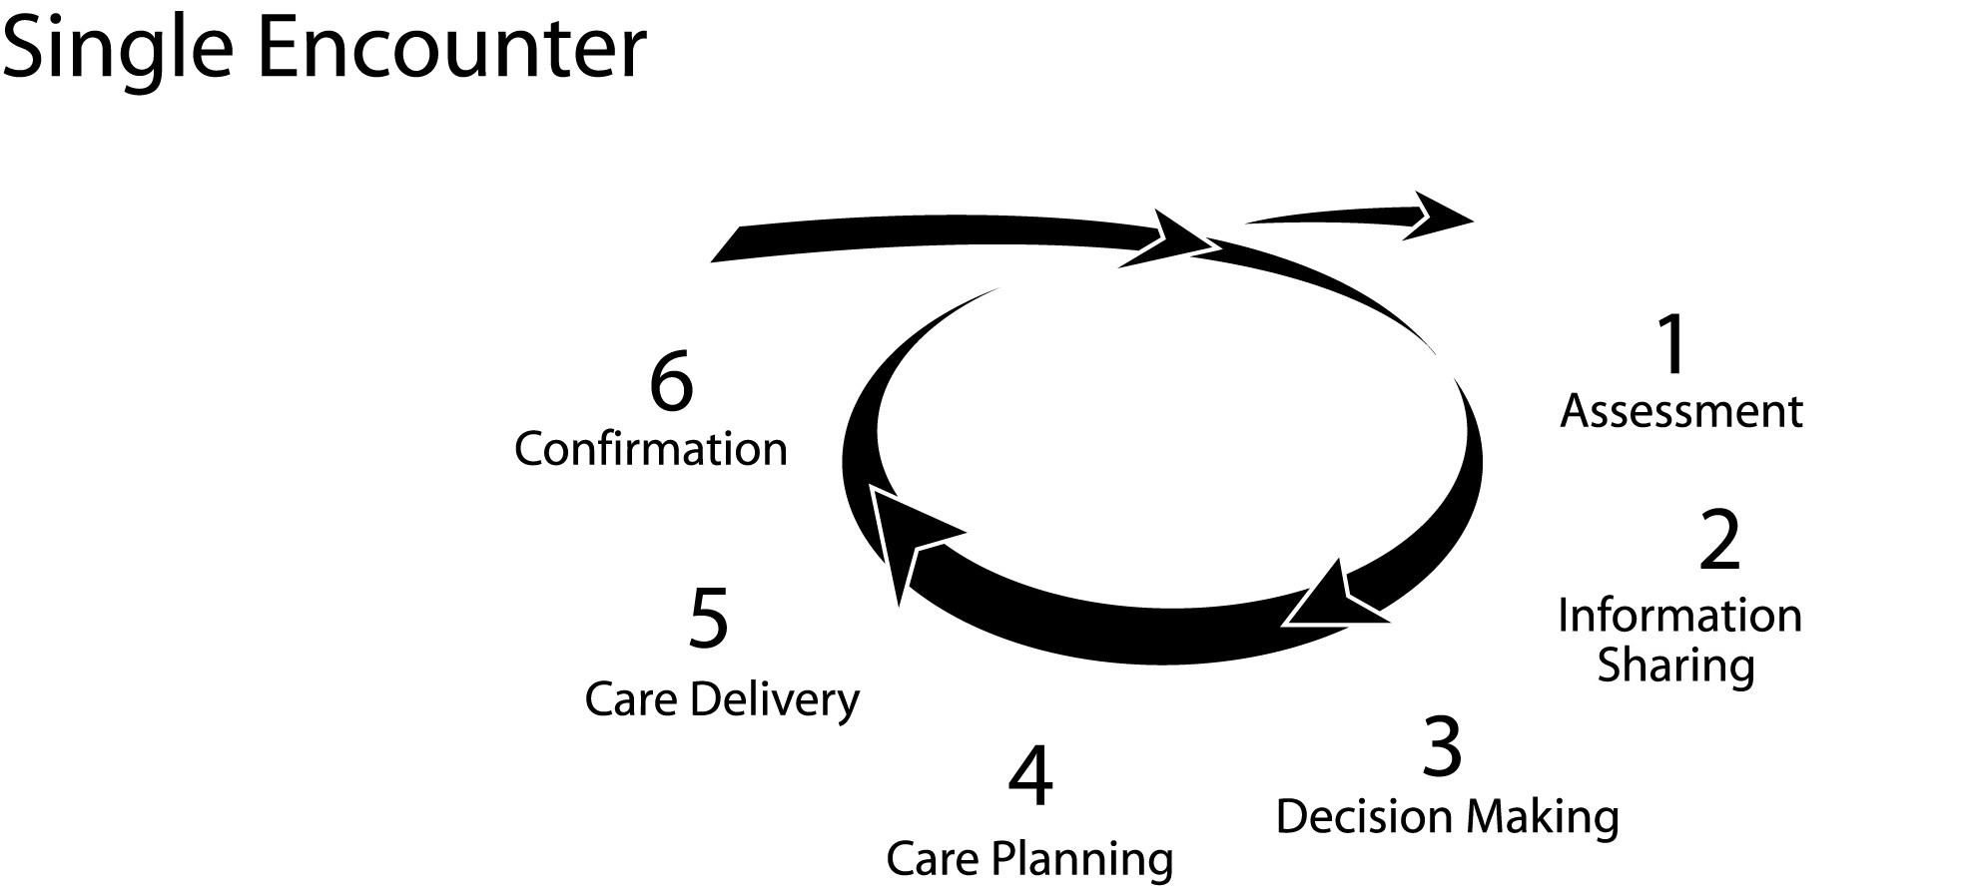

Slide 26
WHOSE RESPONSIBILITY?
It is the right of every person with a life-threatening illness to receive appropriate palliative care wherever they are
(DoH, 1998)
Palliative care is the responsibility of all health and social care professionals delivering care
(NICE, 2004)

Slide 27
THE PALLIATIVE CARE APPROACH
Delivered by the patient’s usual professional carers as a vital and integral part of their routine care delivery
For patients with low to moderate complexity of need
Focuses on the key principles of palliative care
(NCHSPCS, 2002)

Slide 28
SPECIALIST PALLIATIVE CARE (SPC)
SPC teams defined in terms of their core service components, their functions and team composition
Provided for patients an families with moderate to complex palliative care needs
May be provided directly or indirectly
        (NCHSPCS, 2002)

Slide 29
WHAT DOES THE SPECIALIST PALLIATIVE CARE TEAM DO?
Advise on management of symptoms
Provide information on diagnosis, investigations and treatments
Offer emotional, spiritual and social support
Liaise closely with the whole health team with the aim of improving the patients quality of life
Offers support via education to healthcare staff

Slide 30
MEMBERS OF THE PALLIATIVE CARE TEAM
Consultant in Palliative Medicine
3 Clinical Nurse Specialists
Clinical Specialist Occupational Therapist
Secretary
Clinical Specialist Dietician
Clinical Specialist Speech and Language Therapist
Pharmacist

Slide 31
WHO TO REFER
Referral to a Palliative Care Team is appropriate for any patients with an incurable, progressive and fatal illness.

Slide 32
WHO TO REFER
Particularly recommended for:
    Patients with rapidly progressive disease
    Patients with disease presenting unexpected, difficult to control, or rapidly progressing symptoms
    Distressing symptoms, when no relief has been achieved within 48 hours
    Psycho-social distress in patient or family relating to the diagnosis or in facing death
    Where reassurance of a second opinion is sought – by patient, family or other health care professional

Slide 33
KEY MESSAGES:
Philosophy of Palliative Care
Should be available to anybody with a life threatening illness
Focus of care is quality of life, with the autonomy and choice of the patient being upheld
Care is extended to both the patient and those who matter to him/her
A whole system approach is made when planning care with the patient

Slide 34
KEY MESSAGES:
Philosophy of Palliative Care
Palliative care should be delivered by any health/social care professional in care setting of patient’s choosing
Palliative care should begin at diagnosis of life threatening condition, continuing through to death/ bereavement
Specialist Palliative Care is defined in terms of core services, delivered using multi-professional team with skills, knowledge and experience in palliative care
Specialist Palliative Care is needed by only a minority of people with complex problems

Slide 35
THE FOUR QUALITY OF LIFE DOMAINS ARE;
a. Physical,
b. psychological,
c. social and
4. spiritual well-being.

